Slide 1
Whole House Pilot Program
July 14, 2021
Notes:
TITLE SLIDE OPTION A

Slide 2
Impetus for the New Jersey Whole House Program
Climate goals and energy efficiency:
The New Jersey Legislature has identified energy efficiency and conservation as key components of the State’s goal of 100% clean energy by 2050.
Governor Murphy signed the Clean Energy Act in 2018, directing the Board to adopt programs that ensure universal access to energy efficiency and serve the needs of low-income communities.
In 2020, the Energy Master Plan established that the State’s priorities in developing its statewide EE structure are affordability, equity, environmental justice, economic development, decarbonization, and public health.
Addressing equity in energy efficiency:
    Meeting the state’s climate goals will require scaling up residential energy efficiency services, particularly for limited income residents, Black and Brown residents, and residents of underserved, under resourced, and historically excluded communities.
    These residents often occupy older, deteriorated housing, with conditions that negatively impact health and financial and housing stability for families. These are often the same conditions that result in deferral from programs providing critical energy-efficiency services.
    Investment to reduce deferrals from energy efficiency programs and coordination with other housing programs is necessary to create equitable energy efficiency service delivery.

Slide 3
New Jersey Whole House Program
Vision
To meet the state’s climate goals by scaling up and coordinating residential energy efficiency services and healthy homes programs in the state, particularly for limited income residents, Black and Brown residents, older adults, and residents of underserved, and under-resourced communities.
How?
Evidence-based housing interventions
Support housing stability and affordability through lower energy burdens
Address health and safety hazards and improve energy efficiency in housing
Support transformative impacts, including economic stability, career advancement, and improved health outcomes through holistic housing interventions
Our collective opportunity:
    Solve the funding gaps for health and safety remediation
    Break down silos – on the funding side and the delivery side
    Focus on sustainable solutions – so we can solve the problem at scale across the state
3

Slide 4
Challenge: Nexus of 3 Sectors, No Focused Funding
Energy
Each of the 3 sectors lack sufficient funds to address poor housing quality, despite these health/safety hazards preventing them from meeting their goals
Up to 30% of potential EE program customers not able to participate because of housing condition
Unfunded Health/
Safety Hazards
Health
Housing
Healthcare investment in housing as a social determinant is limited in New Jersey
Funding limitations for affordable units and limited substantive programs for housing rehab

Slide 5
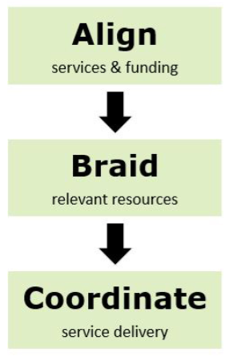

Green and Healthy Homes Initiative
The Green & Healthy Homes Initiative (GHHI) is the nation’s largest healthy homes organization, dedicated to addressing the social determinants of health and advancing racial and health equity through the creation of healthy, safe, and energy efficient homes.
5
Notes:
(from BPU website)

Slide 6
New Jersey Whole House Program Planning Timeline
NJBPU issues RFP for
Whole House Pilot
Design Project
Development of place-based delivery models
2020
2021
2022
Pilot
Implementation
Initiated
2023
Pilot Impact
Analysis
Completed
Focus on aligning current programs and identifying sustainable partnerships for a statewide model
GHHI awarded
Pilot Design
Contract
Asset/Gap
Analysis
Completed

Slide 7
Asset and Gap Analysis

Slide 8










Stakeholder Engagement
Core Project Team
Comfort Partners-Participating Utilities
Department of Environmental Protection
Department of Community Affairs
St. Joseph’s Carpenter Society Camden
United Community Corporation Newark
Greater Bergen Community Action
Isles
RMI
Energy Efficiency Alliance of NJ
Northeast Energy Efficiency Partnerships
Housing & Community Development Network of NJ
Department of Health
Stakeholders Interviewed for the Analysis
Notes:
During the asset and gap report process, GHHI interviewed participating Comfort Partners utilities, state government, and local organizations and service providers.

Slide 9
Resources Identified for Evaluation
The asset and gap analysis identified multiple buckets of potential funding sources for energy efficiency and healthy housing interventions:
Federal
Examples:
Weatherization Assistance Program (WAP)
HUD Lead Hazard Control Grants
HUD Community Development Block Grants (CDBG)
American Rescue Plan
State
Examples:
Lead-Safe Home Remediation Grants
New Jersey Affordable Housing Trust Fund
DCA Neighborhood Revitalization Tax Credit Program
Local
Examples:
Habitat for Humanity
Hospital Community Benefits
Notes:
In the asset and gap analysis, GHHI identified funding opportunities across sectors including energy efficiency and weatherization, lead hazard control, aging in place, healthcare, and general rehab dollars. This has included federal, state, and local funds. The whole house pilot will create an opportunity to coordinate and leverage cross-sector funds to maximize the impact for low-income households and reduce deferrals from the Comfort Partners program.
An example is New Jersey’s Weatherization Assistance Program is already serving low-income households through local agencies and nonprofits with funds to weatherize homes and increase energy efficiency.
GHHI also examined federal and state lead hazard control grants being implemented in local jurisdictions across New Jersey. These may reduce the number of homes deferred from weatherization services due to lead paint in their home. It was announced earlier this month that funds for lead remediation in housing will include $170 million in ARPA funds.
HUD Community Development Block Grants are flexible funds that are being used by cities and counties in New Jersey to invest in lead hazard remediation and general housing rehab projects. Partnering to braid these funds with CP investments can reduce deferrals for homes in need of more extensive home repair.
GHHI also took into consideration existing state home repair dollars being allocated to New Jersey jurisdictions, such as the New Jersey Affordable Housing Trust Funds and the DCA Neighborhood Revitalization Tax Credit Program.
Finally, GHHI examined potential for local partnerships. Habitat for Humanity affiliates currently serve local jurisdictions across New Jersey. Multiple hospital systems are partnering with the New Jersey Housing Mortgage and Finance Agency to invest in housing projects in the communities they serve. Aligning CP weatherization resources with local projects such as these can maximize positive outcomes for residents served and support Comfort Partners service delivery.

Slide 10
Measuring the Need: Comparison Across Select Municipalities
Among other factors, housing-related health indicators, energy burden and housing age were considered in categorizing need at the municipal level.

Slide 11
Racial Disparity and Overlapping Burdens

Slide 12
Pilot considerations

Slide 13
Opportunity
Build on strength of robust service delivery infrastructure: energy-efficiency contractor network serves about 7,000 households each year, and healthy homes and home repair programs combined serve about 1,000 households each year.
1
Evidence is clear that aligned, coordinated housing programs maximize efficiency, and low to moderate income housing requires health and safety repairs to receive energy efficiency upgrades, electrification and clean energy upgrades.
2
Addressing households with highest energy, housing, and health burdens also advances opportunities to achieve racial equity, builds capacity and pathways to sustainable careers, and provides services to those most at risk for housing-related health conditions.
3

Slide 14
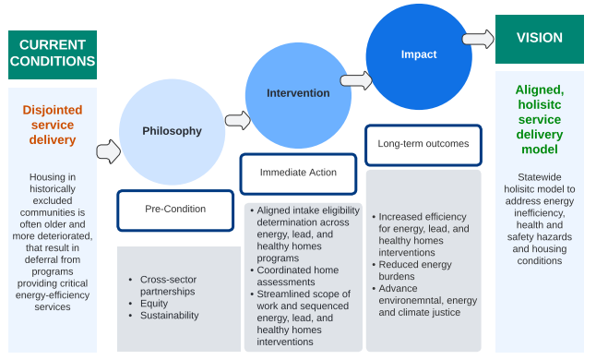
Theory of Change

Slide 15
Pilot Design Considerations
Indicators of Need
Publicly-available community or county-level data
Gaps in Existing Services
Community with resource gaps to test measurable impact, operational feasibility, and sustainability
Scalability
Long term workforce and resource development
Site Selection

Slide 16
How will the Pilot Work?

Slide 17
Outcomes
Energy Efficiency
Reduction in utility usage
Reduction in energy costs
Improved Health Outcomes
Increase in knowledge of asthma triggers
Increase in knowledge in lead-based paint hazards
Client Satisfaction
Quality assurance and quality control evaluations throughout the process
Increase in comfort
Increase in knowledge of weatherization & energy usage
Decrease in asthma-related ED, hospitalization and urgent care visits
Increase in PCP connection
Collection of client satisfaction survey data

